Slide 1
Mobile Accessibility Tools
Camera Switches and More
By Shafik Quoraishee

Slide 2
Introduction
Outline
Introduction
Accessibility shortcuts
VoiceOver
Camera switches
Accessibility Scanner
Tools used
Android
iPad

Slide 3
History Of Accessibility Devices
Early 2000s: Introduction of basic accessibility features such as text-to-speech and voice recognition in early mobile phones, notably by Nokia.
2009: Apple introduced VoiceOver on the iPhone 3GS, setting a new standard for touchscreen accessibility with gesture-based screen reader support.
2011: Google launched the Android Accessibility Suite, including TalkBack, providing comprehensive accessibility tools for Android users.
2018: The W3C released WCAG 2.1, incorporating mobile-specific accessibility guidelines, ensuring better accessibility in mobile content and applications.

Slide 4
Mobile Accessibility Shortcuts
Quick Activation: Accessibility shortcuts allow users to rapidly enable or disable features like screen readers, magnification
Customizable: Users can tailor shortcuts to their specific needs, setting up preferred actions such as triple-clicking the Home or Side button (iOS) or pressing both volume keys (Android)]
Enhanced Navigation: Features like AssistiveTouch (iOS) and the Accessibility Menu (Android) provide on-screen controls for easier device navigation without physical buttons.
Inclusive Design: Accessibility shortcuts ensure mobile devices are usable by individuals with various disabilities,

Slide 5
Accessibility Shortcuts: Android

Slide 6
Accessibility Shortcuts: iOS

Slide 7
Mobile Accessibility Guidelines
Use Clear, Descriptive Text: Ensure that all text elements are easily readable and describe their function or purpose. Avoid ambiguous labels and use meaningful content descriptions.
Design for Keyboard Navigation: Ensure that all interactive elements (buttons, links) can be navigated using a keyboard or screen reader commands, with a logical tab order and focus indicators.
Ensure Color Contrast & Text Scalability: Use high contrast between text and background for readability. Allow text resizing without loss of content or functionality.
Provide Accessible Media & Controls: Include captions for videos, provide audio descriptions, and ensure that all media players are accessible with touch gestures and screen readers.

Slide 8
Content Accessibility Labels
Content Descriptions: Add content descriptions to non-textual elements using android:contentDescription to make images and icons understandable by screen readers
Label Views: Use the android:labelFor attribute to link labels with input fields for better accessibility.
Announce Dynamic Content: Use announceForAccessibility to notify users of dynamic content updates, ensuring screen readers can inform users of changes.

Slide 9
Talkback Demo: Android

Slide 10
VoiceOver Demo: iOS

Slide 11
Camera Switch Access
Camera switches use facial movements or expressions to control mobile devices
Users can assign specific actions, like tapping or scrolling, to different facial movements or expressions
Camera switches can be easily configured through the accessibility settings on mobile devices
This feature expands accessibility, allowing users with physical disabilities to interact with their devices more independently and effectively.

Slide 12
Camera Switch Access (Setup & Demo) - Android

Slide 13
Camera Switch Access (Setup & Demo): Android

Slide 14
Camera Switch Access (Setup & Demo): iOS

Slide 15
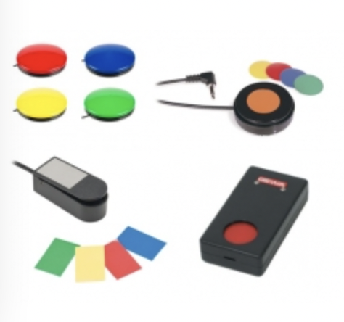
Hardware Switches
Modern mobile operating systems like iOS and Android support switch control, allowing users to operate their devices using physical switches.
Hardware switches come in various forms, including button switches, sip-and-puff systems, and joystick controls.
Many accessibility switches connect to mobile devices via Bluetooth or USB, ensuring compatibility and ease of use.
Users can configure switch actions and create profiles tailored to specific tasks or applications.

Slide 16
Hardware Switch Demo

Slide 17
Live Captions
Live captions provide real-time text transcriptions of spoken words during broadcasts, meetings, and events
They often rely on advanced ASR technology to convert spoken language into text instantly
Modern live captioning systems can support multiple languages, offering translations and transcriptions simultaneously
Live captions can be integrated into various platforms such as Zoom, YouTube, and Microsoft Teams

Slide 18
Live Captions Demo

Slide 19
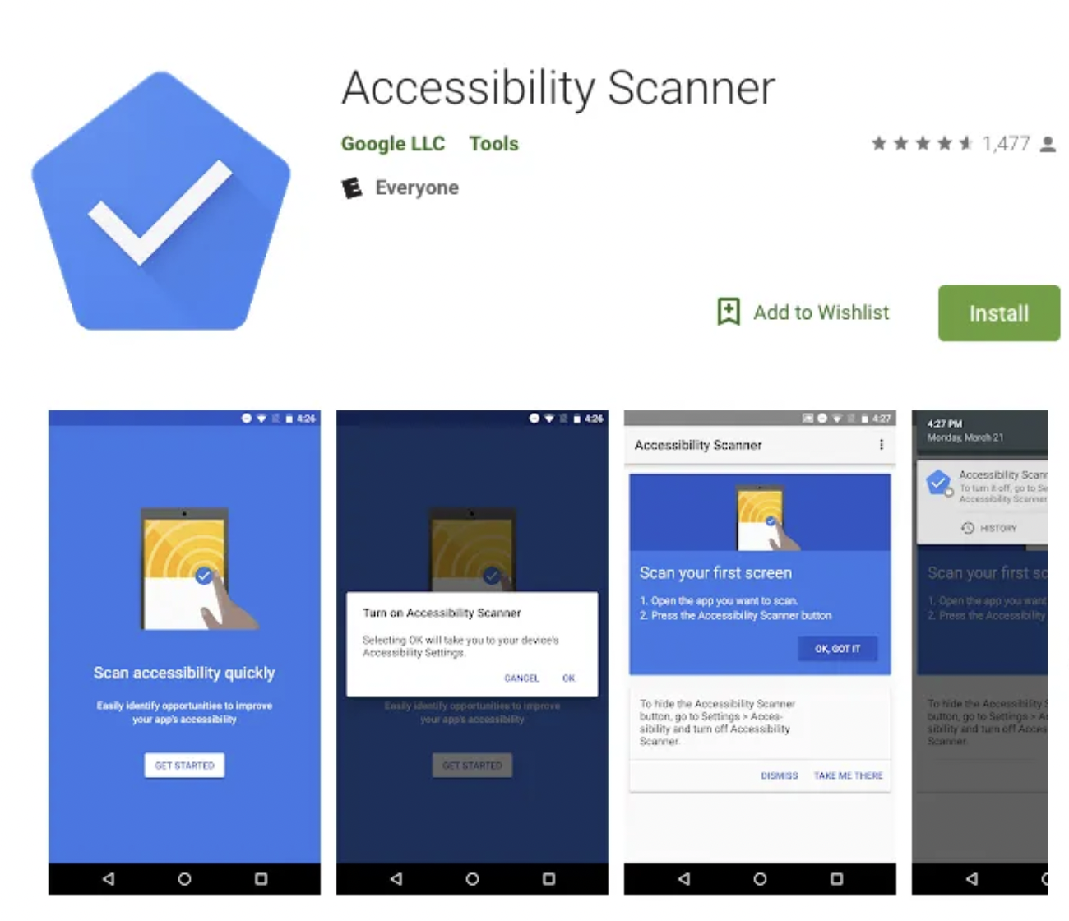
Accessibility Scanner
Accessibility Scanner is a tool that helps identify accessibility issues in Android apps by suggesting improvements based on Google's accessibility guidelines
IIt evaluates app interfaces by analyzing elements like touch targets, content descriptions, and text contrast
The scanner highlights issues such as small touch targets, missing or unclear labels, and insufficient text contrast
Easy to integrate into the development workflow, it supports continuous improvement of app accessibility,

Slide 20
Accessibility Scanner Demo

Slide 21
Be My Eyes
Free mobile app connecting blind and low-vision users with sighted volunteers for visual assistance through live video calls
Available in 185 languages across 150+ countries, with over 6 million volunteers and 24/7 support
Features include volunteer calls, AI image description ("Be My AI"), and specialized help from company representatives
Assists with tasks like reading labels, identifying objects, navigating menus, and operating appliances

Slide 22
Accessibility Statistics
As of 2023, 90% of U.S. adults own a smartphone, and 95% use the internet, indicating widespread access to mobile technology. This statistic highlights the importance of ensuring mobile device accessibility for a significant portion of the population (Pew Research Center)​ (Pew Research Center)​.
A study revealed that 96.8% of homepages had detectable WCAG 2 failures, indicating significant accessibility challenges in mobile web content. Common issues include low-contrast text, missing alternative text, and improperly labeled form inputs (DDIY)​ (DDIY)​​ (PixelPlex)​.
Americans with disabilities are three times as likely as those without a disability to say they never go online (15% vs. 5%). This statistic underscores the need for accessible mobile technology to bridge the digital divide (DDIY)​ (DDIY)​.
The Department of Justice requires that mobile apps used by state and local governments meet WCAG 2.1, Level AA standards to ensure accessibility for people with disabilities. This rule reflects the ongoing effort to standardize accessibility in mobile technology (ADA.gov)​ (ADA.gov)​.
Approximately 15% of U.S. adults are "smartphone dependent," meaning they rely solely on smartphones for internet access without a home broadband subscription. This dependency is higher among lower-income households and underscores the importance of accessible mobile technology (Pew Research Center)​ (Pew Research Center)​.

Slide 23
Q&A

